Slide 1

How to Appeal Medicaid Terminations in Florida
Presented by
Florida Health Justice Project Attorneys:
Lynn Hearn
Miriam Harmatz
Katy DeBriere
January 17, 2024
Notes:
]

Slide 2

Today’s Topics
Introduction and Overview of Medicaid Redeterminations by Florida Department of Children and Families (DCF)
Understanding the DCF Termination Notice
Determining Whether an Appeal is Appropriate
When and How to File an Appeal
How to Prepare for the Appeal Hearing
What to Expect at the Hearing and Afterward

Slide 3
Introduction/Overview
Medicaid eligibility redeterminations required annually
During COVID-19 Public Health Emergency, states required to maintain continuous Medicaid coverage (extra $$)
Florida resumed terminations in April 2023

Slide 4




Introduction/Overview, ctd.
Who is most affected?
  Youth who turned 19-20
  Parents who no longer have children under 18
  Children whose families’ income has increased
  Aged & disabled individuals now on Medicare
  Pregnant/post-partum individuals & newborns
  Many others

Slide 5
Introduction/Overview, ctd.

Slide 6
Introduction/Overview, ctd.
Why appeal?
Medicaid is complicated!
Don’t assume decision is correct
Eligibility limits for children much higher than adults
May preserve coverage during appeal process
Preserves right to reimbursement for out-of-pocket expenses
-

Slide 7
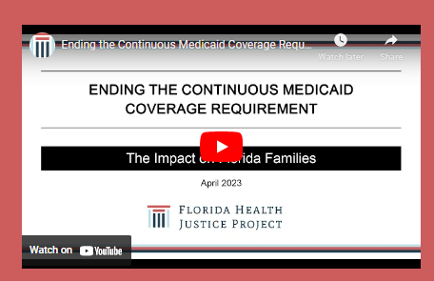
Introduction/Overview, ctd.
Key Resources
Medicaid Appeals Toolkit
Video
Income Charts
Advocate's Guide to Florida Medicaid - Florida Health Justice Project
DCF ESS Program Policy Manual
Chapter 65-2, Florida Administrative Code – DCF Fair Hearing Rules
42 C.F.R. §§ 431.200-431.250 – Federal Fair Hearing Regulations
FHJP Medicaid Termination Referral Form

Slide 8
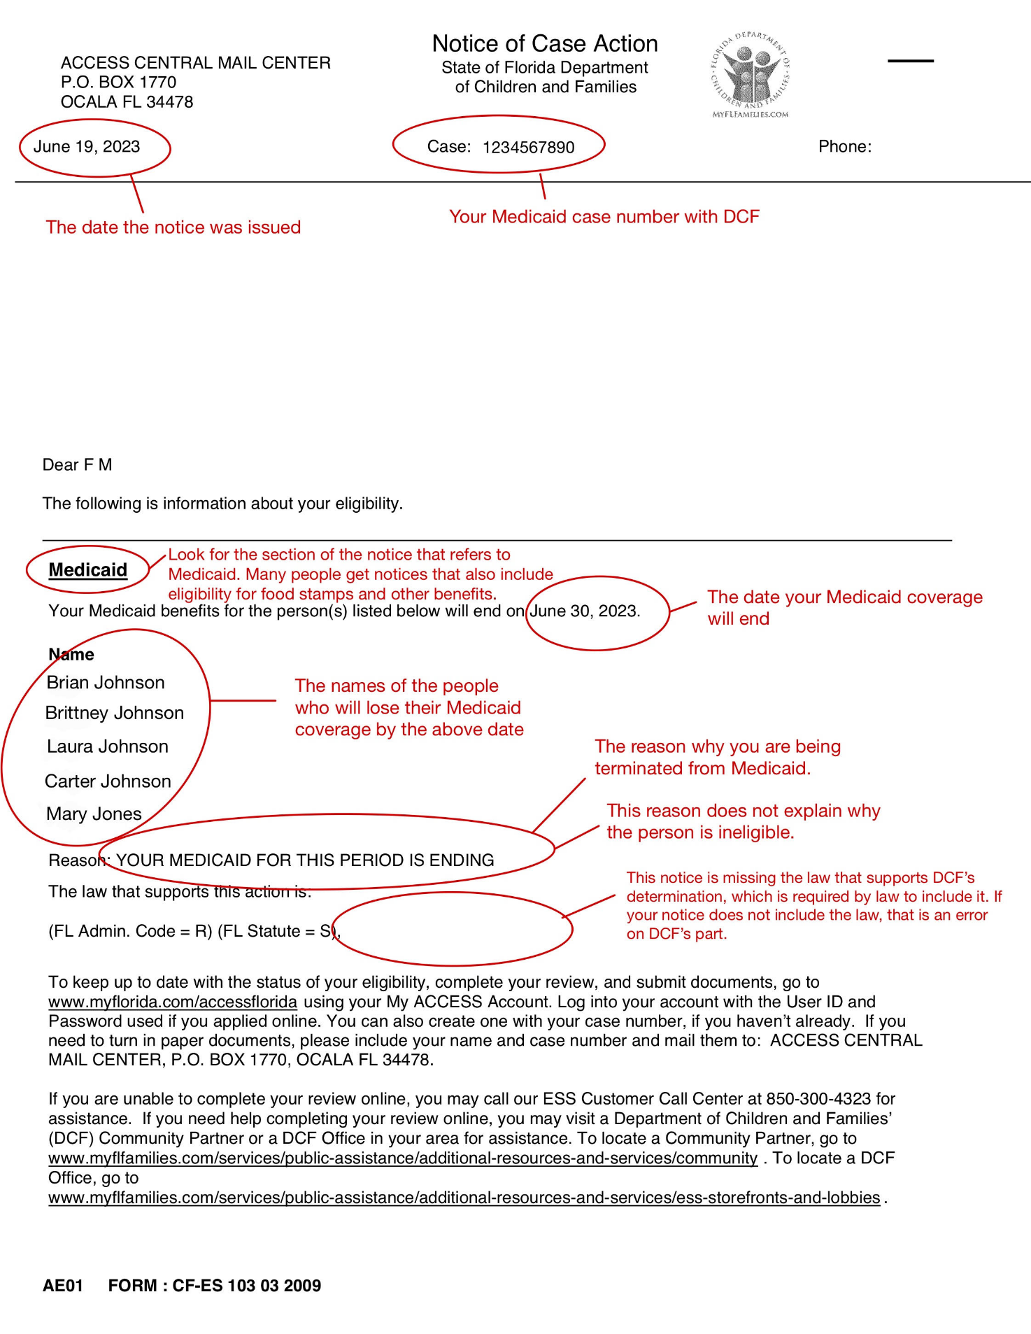
Sample
Notice of Case Action
(“NOCA”)
Identify ending date
Often multiple sections relating to Medicaid
Notice may say “Your Medicaid application/review is denied” = termination
“You are receiving the same type of assistance from another program” = termination
Notes:
Real notice. Notice 11 days between notice and ending date; minimum is 10.

Slide 9
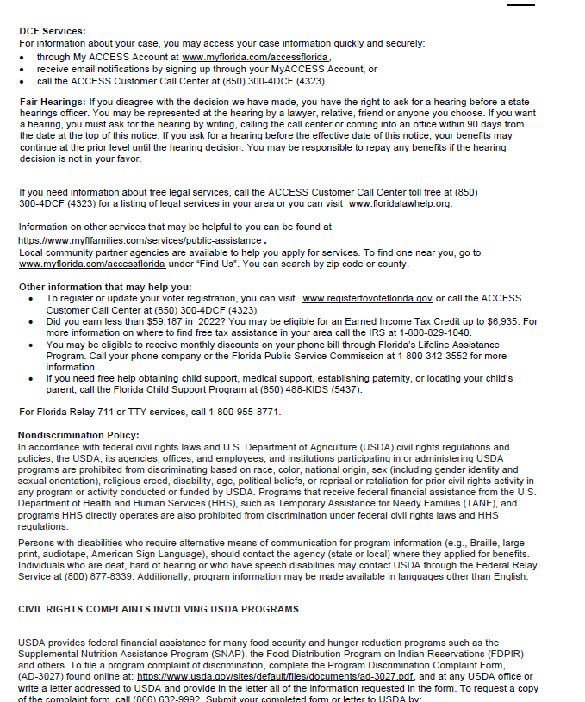
Notice of Right to Appeal
Toward back of NOCA
Omits best ways to file appeal
Medicaid benefits must continue if appeal before effective date
Only responsible to repay benefits in cases of fraud or intentional violation

Slide 10
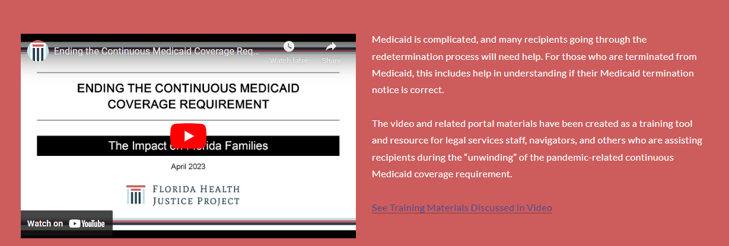
Is an Appeal Appropriate?
Is Medicaid eligibility being terminated?
Conduct your own eligibility determination. See video.
  2024 update coming soon!

Slide 11
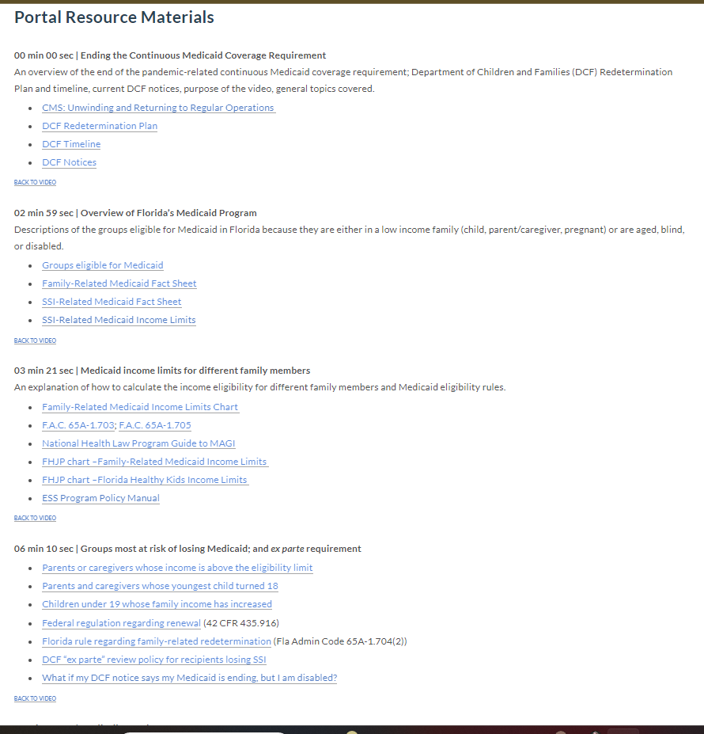
Determining Eligibility, ctd.
Consult portal resources, e.g.:
Income limit charts
ESS Program Policy Manual
NHeLP Guide to MAGI

Slide 12
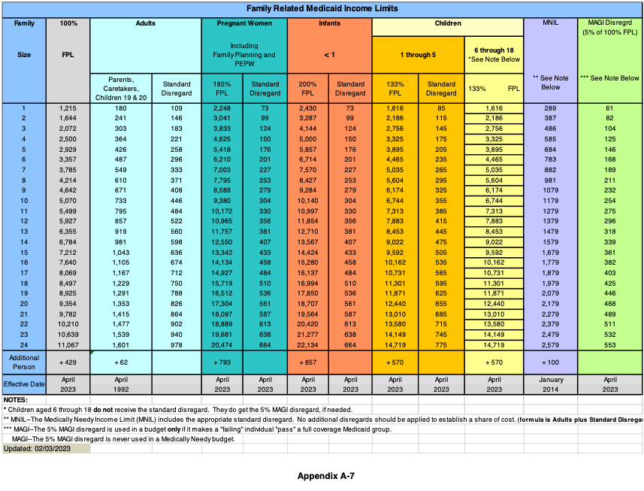

Slide 13
Example: Determining Medicaid income limit for child age 4 in household of 3
$2,756 → Base Amount (133% FPL)
+ $145 → Standard Disregard
+ $104 → MAGI Disregard
= $3,005 → Family Income Limit
Thus, if child’s Medicaid was terminated and family income is less than $3,005/month, an appeal should be filed.

Slide 14
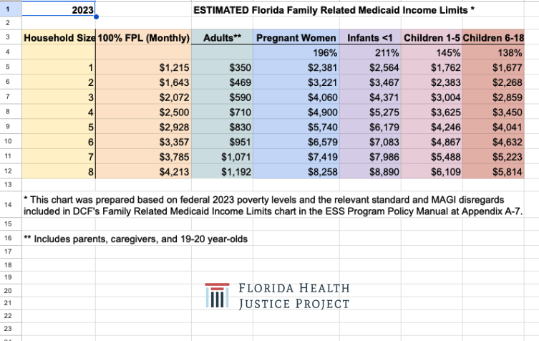

Slide 15
Determining Eligibility
Potential Errors
Outdated/incorrect income information
Improper inclusion of certain income (e.g., SSI)
Improper calculation of household
Failure to provide continuous coverage
  Pregnancy & post-partum
  Children (now 12 months for all under age 19!)
Failure to consider alternative bases for eligibility
  Disability
  Over 65 or disabled & on Medicare - Medicare Savings Plans (QMB, SLMB, QI1)
Application errors

Slide 16
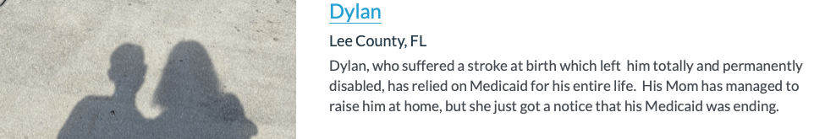
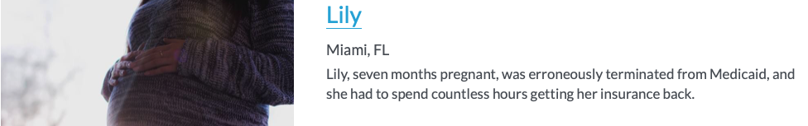
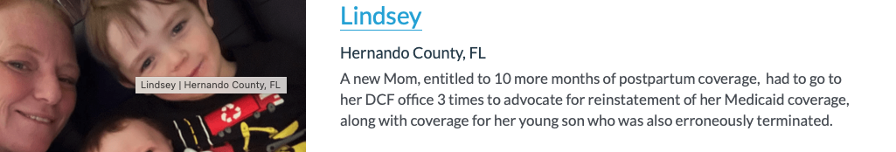
Appealing Terminations
Real Life Stories

Slide 17

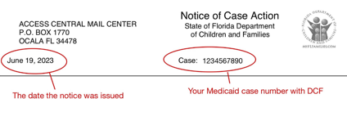

When to Appeal
Before the termination date
– coverage must be maintained
Within 90 days after the date
of the notice

Slide 18
How to File Appeal
First Choice Recommended
Email to appeal.hearing@myflfamilies.com (keeps record)
Template in Toolkit ➔
In person or video (Teams)
Include email and mailing
address
Template for Requesting an Appeal via email:
Re: Appeal on behalf of [First name, Last name], Case No [Medicaid case number]
This email is to appeal the Notice of Case Action dated [date on top of notice] ending Medicaid for [names of all people whose eligibility you are appealing] on [date of end of Medicaid]. I request that the hearing be held [select one: in person / by video conference / by telephone conference].
If you are appealing before the date of termination include:
As this appeal is being filed before the end of my Medicaid coverage, please continue my Medicaid pending the hearing decision.
If you are representing someone in their appeal include:
I will be representing [name of person appealing eligibility] in this appeal. Please let me know if you have any questions.

Slide 19
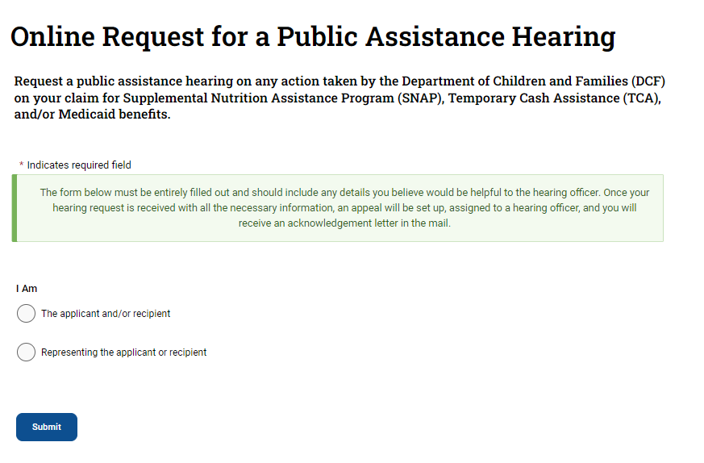
How to File Appeal, ctd.
Second Choice Recommended
Online at https://www.myflfamilies.com/fairhearings
Note: No obligation to complete “why you disagree with the action”

Slide 20

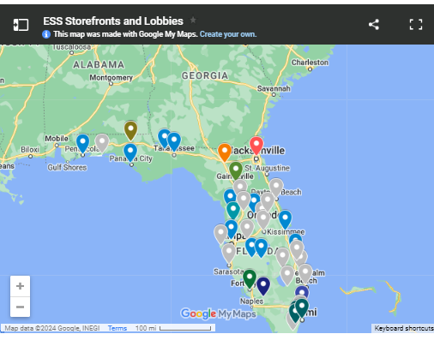

How to File Appeal, ctd.
Other methods, not recommended:
  Calling DCF call center
  Going to DCF office in person
  Sending request via U.S. Mail

Slide 21
Maintaining Benefits
If appeal filed before termination, coverage is required to continue – but often doesn’t!
What to do:
  Check MyACCESS Account
  Call DCF Hearing Contact – follow-up w/email
  If DCF says restored, but physician/pharmacy sees no coverage, contact AHCA
    AHCA Medicaid Helpline 1-877-254-1055 or
    File a complaint with AHCA
  File Motion to Reinstate Medicaid Coverage Pending Appeal

Slide 22

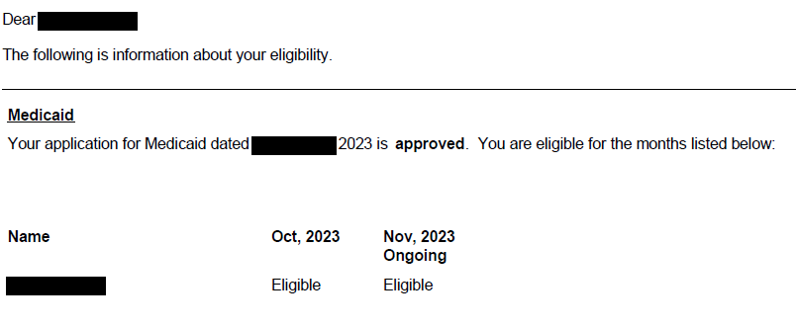
Maintaining Benefits, ctd.
You may receive a NOCA saying Medicaid has been restored.
Does not necessarily mean your eligibility has been resolved!
May only reflect your entitlement to coverage pending appeal.
Check MyACCESS account to look for full year of entitlement to coverage.

Slide 23

After Filing the Appeal
Call from DCF supervisor
Be prepared to ask questions
Do not withdraw appeal based solely on this conversation

Slide 24
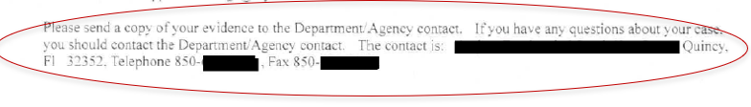
After Filing the Appeal, ctd.
Will receive via U.S. mail:
  “Acknowledgement of Hearing Request”
    Important: Contains DCF contact for appeal
  “Hearings before Office of Appeal Hearings”
  “Notice of Hearing”
  “Hearing Conference Call Instructions”

Slide 25

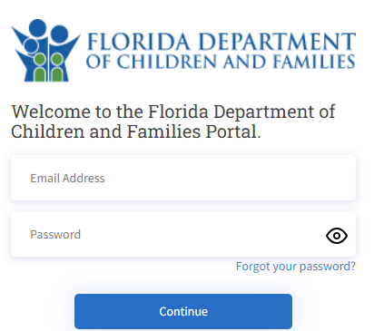
Preparing for the Hearing
Request DCF File – entitled to free copy
Review application
information on MyACCESS
– make sure no errors
Review Eligibility Rules
  FHJP Video & portal
  DCF ESS Program Policy Manual
  NHelp Advocate’s Guide to MAGI
  Referral to FHJP
Conduct Discovery if needed – serve early

Slide 26
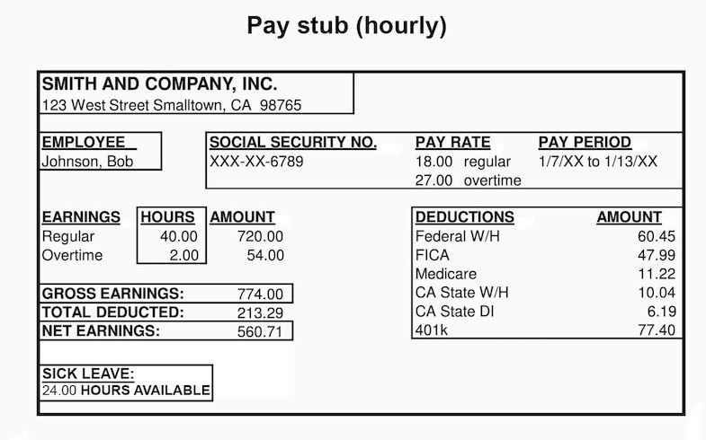

Preparing for the Hearing, ctd.
  New/Changed Information?
  For example, change in income or
  household composition since
  your last application.
    That’s OK!
    Hearing is “de novo” – new evidence is permissible
    Should be disclosed to DCF and Hearing Officer at least 7 days before the hearing

Slide 27



Preparing for the Hearing, ctd.
  Consider court reporter
  7 days before hearing –
  send documents you will use at
  hearing to prove eligibility
    to DCF
    To Hearing Officer
  Talk to DCF contact; try to determine where differences are
Hrg

Slide 28
Preparing for the Hearing, ctd.
Special Situations
  Need more time to prepare?
  Need transportation?
  Back on Medicaid?
Motion for
Continuance
DCF must provide
  Once confirmed on MyACCESS, file Notice of Withdrawal

Slide 29
The Hearing
  1. DCF presents its case first (has burden of proof for terminations)
    You may ask questions of DCF’s representative regarding their testimony or documents
  2. You present your case
    Explain why you believe DCF is incorrect
    Introduce witnesses and documents, if relevant
    DCF’s representative may ask questions of you and your witnesses
  3. Rebuttal – DCF has opportunity to respond to your evidence

Slide 30

The Hearing, ctd.
  Before it’s over, consider:
    Request to keep record open for
      Additional evidence
      Submission of proposed order

Slide 31
After the Hearing
Final Order -- due 90 days after appeal filed (extended by party delays)
If you win ….
DCF must comply within 10 days
Must authorize corrective action (retroactive)
Entitled to refund of out-of-pocket and/or payment of unpaid medical expenses from AHCA

Slide 32
After the Hearing
If you lose . . .
Can appeal to District Court of Appeal (30 days)
        May not submit new evidence
        Must show (1) finding of fact not supported by evidence; (2) significant error in procedure that affected fairness of hearing; or (3) incorrect interpretation of law on important issue
Repayment – only following a separate finding of fraud or intentional program violation

Slide 33
Questions?
Thank You!
Lynn Hearn
Miriam Harmatz
Katy DeBriere
CLE# 2313762N
Evaluation form

