Slide 1
Medicaid Managed Care: Helping Elderly Clients Obtain Medically Necessary Services
Florida Elder Justice Conference, Tampa ,FL
April 12, 2019
Katy Debriere, Managing Attorney, Northeast Florida Medical Legal Partnership, Jacksonville Area Legal Aid, Inc.& Legal Director, Florida Health Justice Project
Anne Swerlick, Policy Analyst and Attorney, Florida Policy Institute
Miriam Harmatz, Executive Director, Florida Health Justice Project
Notes:
Why this Guide? One of most confusng and most important benefits in Medicaid program; as population ages, need increases way over half of us need at one time or another—hard enough on middle class, perhaps can pay for out of savings—but for low income—grave risk of institutionalization ; not covered by Medicare
illustrates couple of the overriding issues in health care system as whole—FLs Medicaid program underfunded by state leg—a problem exacerbated by the fact that the state has not yet expanded Medicaid; and the wait list for these services, also exacerbate by non expansion because those on the WL between xx and xx of FPL would be on regular Medicaid if/when state expands, and for regular Medicaid enrollees. home health services are available

Slide 2
Overview of Session
Governing Authority
Coverage standards
Advocate tips and tools
Disenrollment, complaints, grievances, appeals, hearings: Who , what, when, where, how?
Available resources
Ideas for outreach and education?

Slide 3
What are Some Resources?

Slide 4
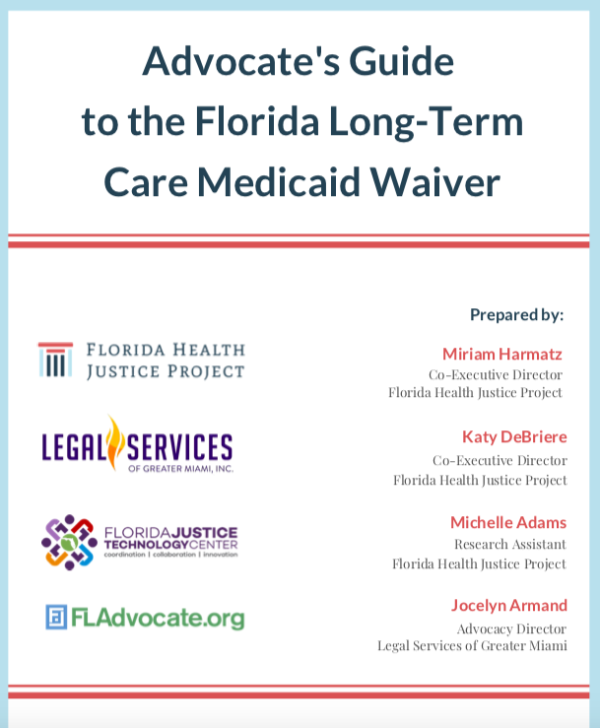
r

Slide 5
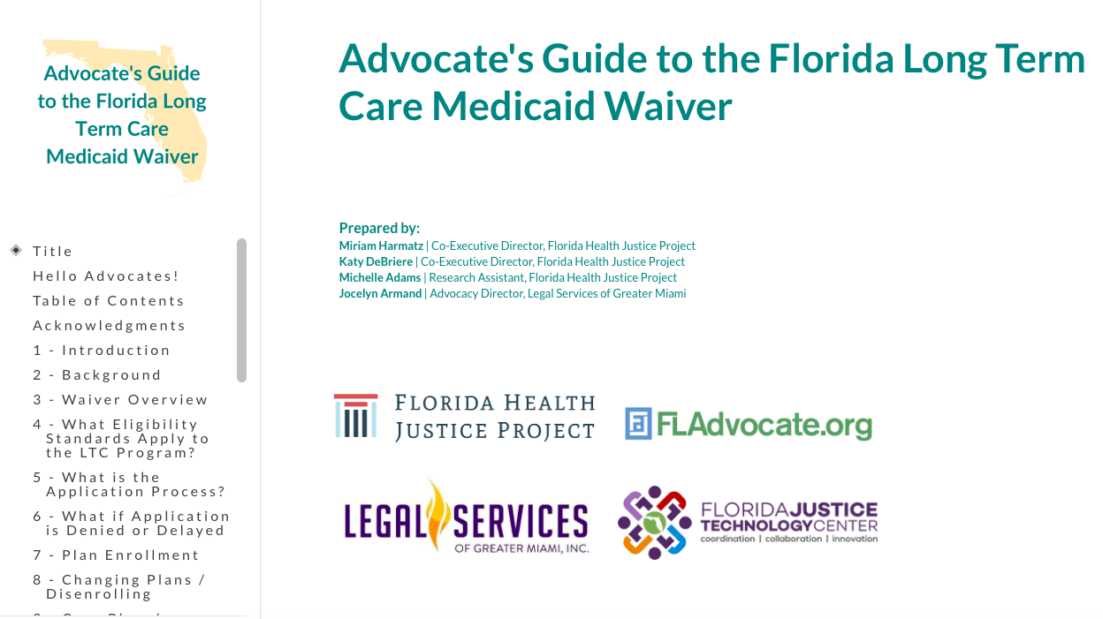
On-line Web Based Guide
Notes:
So FHJP did this guide, along with o author LSGMI. Note at outset, got lot of tech assistance help form the state and national experts in xxxxx and help with review form people who had much more first hand expertise with the benefit, including EC , NW, AS, VG. And asked version so …..was released last week and on all our websites, so you don’t need to take extensive notes today. And instead we can just go through and highlight some issues and put pins in some things that would be worth following up on with partners between ADRCs, legal services and others.
Also want to note that in the Guide today, when refer to LTC waiver, we are only talking about that part that involves HCBS—not nursing home care.

Slide 6
Overview of Guide
Who is eligible?
How to apply?
What to do if application denied or delayed?
How does waiting list work?
What to do if eligibility is terminated?
What services are covered and how is care plan developed?
How does managed care work?
What to do if services are delayed, denied, terminated or reduced?
Notes:
Had 2 major goals in doing guide—we wanted to have a road map that would provide the context and brief discussion around each of these points AND we wanted to provide all of the citations to the underlying legal authority for the Waiver. It’s an occupational hazard of lawyers that we just like to see all the legal sources, and how those sources connect in –particularly and what authority should I be looking at if I’m trying to help a frail or disabled client either get into the waiver or get services once in the waiver we can look at this Guide and figure out the basis for pointing out, typically to the MCO or AHCA, why someone needs to do x, y , or Z for my client.

Slide 7
What Authority Governs?
See, Advocates Guide, section 15
Federal statute
Federal regulations (C.F.R.)
State statute
State rule (F.A.C.)
Waiver application and approval
Agency for Health Care (AHCA)Model Contract
Contract MMA and LTC attachments
DOEA Program Manual (LTC)

Slide 8
What Plans are Available?
Managed Medical Assistance (MMA)
Not available for those eligible for LTC services
Long Term Care Plus (LTC+)
MMA services + LTC services
Not available to those only eligible for MMA
Comprehensive
MMA Services + LTC services
Specialty
Dental

Slide 9
What Services are Covered?
State Statute
Contract
Rule
Coverages, Services, & Limitations Handbooks: http://ahca.myflorida.com/medicaid/review/index.shtml
“Mixed” services

Slide 10
What Coverage Standards Apply?
Medical necessity
What is the general standard in Florida?
What is the standard for HCBS?
Other HCBS coverage criteria
Supplemental assessment

Slide 11
Florida’s Definition of Medical Necessity
1) Be necessary to protect life, to prevent significant illness or significant disability, or to alleviate severe pain;
2) Be individualized, specific, and consistent with symptoms or confirmed diagnosis of the illness or injury under treatment, and not in excess of the patient’s needs;
3) Be consistent with generally accepted professional medical standards as determined by the Medicaid program, and not experimental or investigational;
4) Be reflective of the level of service that can be safely furnished, and for which no equally effective and more conservative or less costly treatment is available statewide and;
5) Be furnished in a manner not primarily intended for the convenience of the recipient, the recipient’s caretaker, or the provider.

Slide 12
Medical Necessity Definition for HCBS
Be individualized, specific, and consistent with symptoms or confirmed diagnosis of the illness or injury under treatment, and not in excess of the patient’s needs (#2);
Be reflective of the level of service that can be safely furnished, and for which no equally effective and more conservative or less costly treatment is available statewide (#4) and;
Be furnished in a manner not primarily intended for the convenience of the recipient, the recipient’s caretaker, or the provider (#5).
And one of the following:
Enable the enrollee to maintain or regain functional capacity; or
Enable the enrollee to have access to the benefits of the community living, to achieve person-centered goals, and to live and work in the selling of her or her choice.

Slide 13
LTC Network Adequacy /Time Standards
Reasonable promptness: statute/ regs/case law
What are network adequacy requirements?
Number of providers/Travel time
2 providers for each county
30 minutes urban
60 minutes rural
Time standards
Initial visit within 5 days of enrollment
Begin services within 7 days following initial visit
Current contract No beginning services time frame
Still in liquidated damages

Slide 14
MMA Network Adequacy /Time Standards
Network Adequacy
May change under proposed amendments to federal rules
Essential Providers
Time
Urgent Care: within 1 day
Sick Care: within 1 week
Well Care: within 1 month
Distance (extensive list in Model Contract)
Primary Care: within 20 miles
Specialists: 75 miles (urban)/90 miles (rural)
Facilities/Hospitals: within 20 miles
Behavioral Health: within 20 miles (urban) or 45 miles (rural)

Slide 15
Good Cause for Disenrollment
Upon initial enrollment, “mandatory managed care” beneficiaries have up to 120 days to change plans.
After that, they are locked into their plans for 12 months, unless they can show “good cause” for changing plans.
Good cause requests can be by phone or in writing to AHCA or the enrollment broker

Slide 16
Good Cause for Disenrollment
No Grievance Exhaustion Required – do not have to first seek resolution through the plan- 59G-8.600(3) (a)
Enrollee is receiving a medically necessary, active and continuing course of treatment from a provider that is not in the managed care plan’s network, but is in the network of the managed care plan requested by the enrollee.
Managed care plan does not cover the service the enrollee seeks because of moral or religious objections.
The resident would have to change his or her residential institutional provider based on the provider’s change in status from an in-network to an out-of network provider with the managed care plan.
Fraudulent enrollment
The enrollee is an American Indian or Alaskan Native as defined in 42 CFR 438.14(a). (In AHCA’s core contract)

Slide 17
Good Cause for Disenrollment
Must First Seek Exhaustion Under Grievance Policy -59G-8.600(3)(b)
Enrollee needs related services to be performed concurrently, but not all related services are available within the managed care plan’s network, and the enrollee’s primary care provider (PCP) has determined that receiving the services separately would subject the enrollee to unnecessary risk.
Poor quality of care.
Lack of access to services covered under the managed care plan’s contract with AHCA, including lack of access to medically-necessary specialty services.
Lack of access to managed care plan providers experienced in dealing with the enrollee’s health care needs.
Enrollee experienced an unreasonable delay or denial of service pursuant to Section 409.969(2), F.S.

Slide 18
Good Cause for Disenrollment- no exhaustion required
If beneficiary asserts any of the above grounds, specified in 59G-8.600(b), and: “immediate risk of permanent damage to the enrollee’s health is alleged.”

Slide 19
Timeframe for Disenrollment determinations
With or without exhaustion, the effective date of an approved disenrollment must be no later than the first day of the second month following the month in which the enrollee requests disenrollment
If a determination is not made within that timeframe the disenrollment is considered effective per the above timeframe.

Slide 20
Complaints, Grievances, & Appeals
Three ways to resolve a Medicaid managed care issue
Complaints
AHCA
Dissatisfaction with process, plan, or provider
Grievances
Plan
Dissatisfaction with plan or provider
Appeals
Plan
Limited to Adverse Benefits Determinations

Slide 21
Complaints AHCA SMMC Complaint Hub
How?
Online: https://apps.ahca.myflorida.com/smmc_cirts/; can upload supporting documents
Phone: 877-254-1055
Why?
Anything
Network adequacy like violation of time/distance standards or no provider available
Quality of care of provider or services: Medicaid transportation
Difficulty with enrollment process
Who?
Anyone can file a complaint; can remain anonymous
Must have AHCA release for follow up information (upload if online)

Slide 22
Grievances
Internal complaint with the plan
No deadline; file any time
Filed orally in writing
Plan must:
Acknowledge receipt in writing within 5 business days
Resolve within 90 days
Assist in filing
No appeal after resolution

Slide 23
Appeals
Only Adverse Benefit Determinations (“ABD”)
Denial by plan of requested service or supplies
Reduction, termination, or suspension by the plan of a previously authorized service
Failure of the plan to provide services in a timely manner as specified by AHCA contract
Denial by the plan of an enrollee’s request to dispute a Florida Medicaid financial liability, including: copayments and coinsurance**
Deadlines
Filed orally or in writing within 60 days from date of ABD notice → plan must confirm receipt within 5 days
If orally, follow up in writing within 10 days**
Aid Paid Pending: must continue services if:
Termination, suspension, or reduction of service
Authorization period not expired
Appeal within 10 days of ABD Notice
**May change under current proposed amendments to federal rules

Slide 24
Appeals: Notice
Content
Action to be taken and reason
Explanation of right to appeal and how to request (also contained in member handbook): must include process for expedited appeals
Enrollees right to all information to the determination which includes criteria used in making determination
Right to aid paid pending and process for requesting it
Must be dated
Language accessibility
Timing
For termination, suspension, or reduction: 10 days before date of action
Denial of payment: at time of the action
Denial of services: within 14 calendar days – plan may extend if in writing
Request for expedited prior service auth: within 72 hrs

Slide 25
Appeals: Process
Submission dependent on the plan; plan is required to assist in filing appeal
Expedited appeal: where the standard appeal resolution timeframe could seriously jeopardize the enrollee’s life, physical or mental health, or ability to attain, maintain, or regain maximum function.
Making the case
Right to case file, including medical records and any new or additional evidence
Right to present evidence
Make legal and factual arguments
Resolution content: “Notice of Plan Appeal Resolution” or “NPAR”
In writing
Results of the appeal and completion date
Right to request fair hearing including process to do so and right to continued benefits
Resolution deadlines
Within 30 calendar days from receipt of appeal unless extended*
Within 72 hrs from receipt of appeal unless extended*

Slide 26
Appeals: Exhaustion
Must file an appeal with the plan before you can request a state fair hearing
Exceptions to exhaustion (“deemed exhaustion”): can immediately file appeal with the state
Plan fails to adhere to resolution deadlines
Plan fails to adhere to time and notice requirements
Failure to provide services requested by the enrollee with reasonable promptness (~90 days) and subsequent failure to issue notice

Slide 27
Fair Hearings
Must be within 120 days of receiving NPAR
How to request
AHCA Medicaid Hearing Unit
877-254-1055
MedicaidHearingUnit@AHCA.myflorida.com
Fax: 239-338-2642
Orally or in writing
Name of filer; name of affected party if different
Medicaid ID
Telephone, mailing address, email
Details: attach NPAR if possible
Parties: plan & enrollee
File authorized representative form
Continued benefits: must request hearing within 10 days of the date of the NPAR
Other matters within managed care: denied request to disenroll from a plan

Slide 28
Conduct of Fair Hearing
Discovery
Must be provided case file within 7 days of request
Other discovery tools available including: interrogatories, requests for production, requests for admissions, and depositions
Evidence to Hearing Officer 10 days prior to hearing
Telephonic
De novo: new evidence must be considered
Parties may:
Make opening/closing statements
Introduce own and rebut other’s evidence
Question witnesses
Call own witnesses
Final Orders
Within 90 days of the fair hearing request unless extended
District Court of Appeal

Slide 29
Keep the conversation going…
Florida Advocate Health Senior Practice Group
https://www.fladvocate.org/healthandsenior/
Contact information:
Katy DeBriere
Katy.debriere@jaxlegalaid.org, DeBriere@floridahealthjustice.org
Miriam Harmatz
haramatz@floridahealthjustice.org
Anne Swerlick
swerlick@fpi.institute
Nancy Wright
newright@gmail.com

Slide 30
Hypotheticals
Hypo # 1
After this conference, you approach your program’s Development Director about starting a project to assist low-income elderly frail and disabled community members in need of (more) home health care or other Medicaid services. Your program’s current OAA grant funding is targeted to the overwhelming number of requests for assistance in housing by low-income elders in your service area and no one in your program currently handles Medicaid cases (other than eligibility).
Together you draft a grant proposal to help seniors on Medicaid navigate the complaint, grievance and appeal systems in managed care. The initial proposal has been approved, and the funder has asked you to include a strategic outreach plan with your final grant proposal specifically describing how you would identify clients who could benefit from the proposal.
What are some initial ideas you can jot down before going to a brainstorming session with your local ADRC partner?

Slide 31
Hypos, cont.
# 2
Anna is a 78 year old woman enrolled in United Health (non LTC). She resides in Baker County which is a very rural area. Anna trips in her home and experiences a nasty fall. She is hospitalized at a hospital in nearby Duval County. She spends a week in the hospital and is finally ready for discharge.
As the social worker is working on the discharge plan, he discovers only one home health agency can staff Anna's wound care needs given her rural location. The home health agency is not in network with United Healthcare but is in network with Sunshine. What can you do to help facilitate Anna's discharge?

Slide 32
Hypos, cont.
# 3
Michael is a 64 year old man who was recently referred to an Endocrinologist by his primary care physician with whom you partner. Michael lives in Walton County. The primary care physician informs you that the closest endocrinologist is in Leon County (138 miles from your client's home with a drive time of approximately 2 hours).
The physician is also concerned that, because Michael has serious lower back pain issues and a catheter, that the drive will be too difficult for him. However, knowing the importance of the Endocrinologist's work up, the physician states that Michael will just have to make the trip. Can you help the physician connect his patient to needed care that accommodates his patient's location and disability?

Slide 33
Hypos, cont.
# 4
C.C. is an 82 year old resident of Miami Florida with Alzheimer's. A widow she lives with her adult daughter who is C.C's caretaker and guardian. C.C. needs constant supervision and assistance with all of her activities of daily living including dressing, eating and bathing.
C.C.'s daughter has been caring for her mother in her home for more than 6 years. She has been paying out of pocket for home health care but is now at the breaking point financially. Her job requires that she work 60 hours per week. She needs to keep this job so she can support both herself and her mother.
Ultimately, C.C. is accepted and enrolled into the LTC Medicaid Waiver program. For her mother's plan of care, the daughter requests 70 hours of in-home care to cover time the daughter must be away at work and doing household errands. The health plan only agrees to provide 40 hours of in-home care stating that the extra hours are only needed for the daughter's "convenience" and that they do not cover "custodial care."
What can you do to advocate for increased in-home hours for C.C.?

Slide 34
Hypos, cont.
# 5
Jane’s daughter Mary calls your office on April 15 about her Mom. Jane suffers from severe dementia, she is paralyzed and incontinent. She was enrolled in a Comprehensive Plan, Plan X, effective March 18. Mary was pleased that a Plan X case manager came within the week on March 21, and prepared a plan of care that provided Jane with all of the home health care assistance that Mary and her mother’s doctor believe is needed, as well as other services.
However, it has now been over 3 weeks since the initial visit and Jane has only received a fraction of the home health care hours of services that were authorized. Mary called the plan and they don’t disagree that Jane needs the authorized services and promise that they are trying to find a providers asap. Mary has also filed an on-line complaint with AHCA and called the Agency; they too say they are working on your mother’s case with Plan X. There is no notice of an Adverse Benefit Determination), and your legal aid program only accepts cases on behalf of clients who have received an ABD. What can be done?

Slide 35
Hypos, cont.
#6
You have a robust Fair Housing program in your office. The directing attorney asks you to staff a case with her. Her client is a 62 year old man with significant physical disabilities (cannot ambulate or transfer independently). The supportive housing apartment complex where the man has resided for the past 10 years has given him notice of eviction for failing to maintain the cleanliness of his apartment. The client is enrolled in the LTC waiver and has an assigned case manager. He receives house cleaning services 3x per week. He often has feces on the floor because, when he needs to toilet, there is no one to help him transfer. The service does not clean the feces well because the client, who has a serious and persistent mental illness, directs them not to. The directing attorney wants to know if the LTC waiver is doing all they can to help this man stay in his apartment. The attorney also wants to know about the LTC waiver case manager’s role.
What kinds of questions should you ask to determine whether your Medicaid advocacy can assist this client in requesting a reasonable accommodation and avoiding present and future eviction attempts?

